Slide 1
Optimizing a System of Electric Vehicle Charging Stations
University of Texas at Arlington
Dissertation Defense
Ukesh Chawal, Ph.D. student
Supervising Professors: Dr. Jay Rosenberger, Dr. Victoria Chen
Committee: Dr. John Priest, Dr. Wei-Jen Lee, Dr. Aera LeBoulluec Department of Industrial & Manufacturing Systems Engineering
This research is partially supported by National Science Foundation grant ECCS-1128871.
Ukesh Chawal
Notes:
Thank you Dr. Jay. Good Afternoon everyone. Thank you for coming to my dissertation defense. The topic of my dissertation defense is Optimizing a System of Electric Vehicle Charging Stations. My supervising professors are Dr. Jay Rosenbergerber and Dr. Victoria Chen and my committee members are Dr. John Priest, Dr. Wei-Jen Lee and Dr. Aera LeBoulluec. This research is partially supported by National Science Foundation grant.

Slide 2
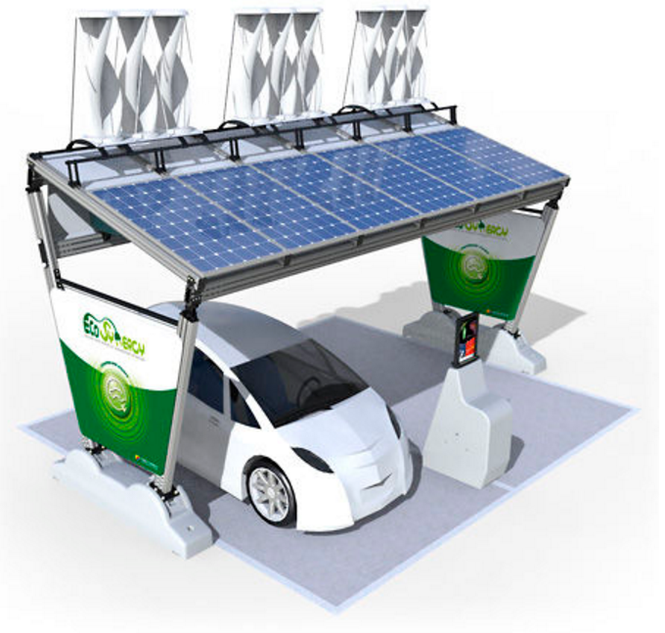
Presentation Outline
Problem Definition
Dissertation Contribution
Summary of Proposal
Post-Proposal Research Contribution
A Two-Stage Design and Analysis of Computer Experiments (DACE) Approach
Experimental Results
Future Work
Source: https://www.pinterest.com/berat3854/solar/
Ukesh Chawal
2
Notes:
Today at first I will briefly explain the problem definition. Then I will go over this dissertation contribution. Then I will describe the summary of my proposal, its importance and also its limitation which leads to the importance of Post-Proposal Research. Then, I will mention the methodology we used in our post-proposal research which is a two stage… Then I will present the experimental results. Finally, I will mention about the future work.

Slide 3
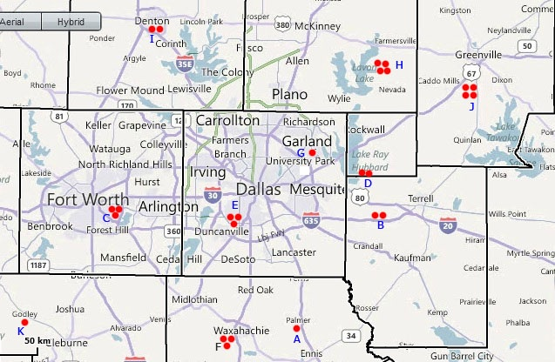

Problem Definition
Where should the charging stations be built?
9. Denton
8. Plano
10. Greenville
7.Garland
4. Rockwall
3. Fort Worth
5. Dallas
2. Heartland
11. Godley
1. Palmer
6. Waxahachie
Ukesh Chawal
3
Notes:
As, I have already mentioned in my proposal we have assumed 11 potential location of the charging stations such as 1 as Palmer, 2 as Heartland, 3 as Fort Worth and so on..
Talking about the problem definition, the first question is where should the charging stations be built?

Slide 4
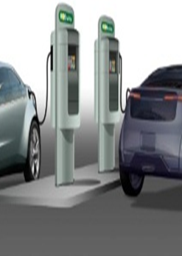
Problem Definition
How many slots to be opened at each station?
9. Denton
8. Plano
10. Greenville
7.Garland
4. Rockwall
3. Fort Worth
5. Dallas
2. Heartland
11. Godley
1. Palmer
6. Waxahachie
Ukesh Chawal
4
Notes:
Then the other questions is how many….. Slots are basically the charging port where the electric vehicles are charged.

Slide 5



Problem Definition
How much revenue can be generated from power trading component?
How much revenue can be generated from sales component?
9. Denton
8. Plano
10. Greenville
7.Garland
4. Rockwall
3. Fort Worth
5. Dallas
2. Heartland
11. Godley
1. Palmer
6. Waxahachie
Ukesh Chawal
5
Notes:
Power trading component - revenue benefit from selling electricity from our grid to the other grid.
Sales component - revenue benefit from meeting the demand of EV vehicle

Slide 6
Presentation Outline
Problem Definition
Dissertation Contribution
Summary of Proposal
Post-Proposal Research Contribution
A Two-Stage Design and Analysis of Computer Experiments (DACE) Approach
Experimental Results
Future Work
Source: https://www.pinterest.com/berat3854/solar/
Ukesh Chawal
6
Notes:
Now I will go over this dissertation contribution.

Slide 7
Dissertation Contribution
Three major contributions
Mixed-Integer Linear Programming (MILP)
The system of EV charging stations
The locations of the stations and the number of slots to be opened
The overall profits
Drawback
Deterministic model
High computational time (as much as 5 days)
Ukesh Chawal
7
Notes:
There are three major contributions of this dissertation. The first component of this dissertation is to formulate a Mixed-Integer Linear Programming (MILP) model to optimize the system of EV charging stations which includes optimizing the…

Slide 8
Dissertation Contribution Cont..
Three major contributions
Design and Analysis of Computer Experiments (DACE) based Approximate Dynamic Programming (ADP) approach
Stochastic model
A two-stage DACE framework
The first stage (master problem) addresses the EV system problem, while the second stage (sub problem) addresses the dynamic control problem.
DACE based MILP approach
Deterministic model
Comparing the computational time to that of MILP (5 days), it reduced to less than an hour, making it a much more suitable option for practical use.
Ukesh Chawal
8
Notes:
In order to mitigate the limitations of the first component, the second component of this dissertation is to develop a ….
The third component of this dissertation is to utilize this approach in deterministic environment which is …
These results are specific to this case study.

Slide 9
Comparisons between different approaches
 | Globally Optimal Solution Approaches | Approximate Solution Approaches
Deterministic EV problem | MILP (Branch and Bound) ​ | DACE based MILP
Stochastic EV problem | Does not exist | DACE based ADP
Compare the designs, solutions and CPU times obtained from all the methods
Ukesh Chawal
9
Notes:
So, here we have 2 problems – one is deterministic EV problem and the other one is stochastic EV problem. For deterministic, MILP is the globally optimal solution approach. For stochastic, currently there exists no approaches that can globally optimize our stochastic dynamic problem. So we developed an approximate solution approach to solve it which is DACE based ADP approach. Since, we cannot evaluate the quality of our approximate DACE approach in stochastic environment, we employed our approximate DACE approach in deterministic environment to evaluate its quality.

Slide 10
Presentation Outline
Problem Definition
Dissertation Contribution
Summary of Proposal
Post-Proposal Research Contribution
A Two-Stage Design and Analysis of Computer Experiments (DACE) Approach
Experimental Results
Future Work
Source: https://www.pinterest.com/berat3854/solar/
Ukesh Chawal
10
Notes:
Now I will describe about the summary of my proposal, its importance and also its limitation.

Slide 11
Summary of Proposal
A deterministic MILP model
System of EV charging stations
System design
Number and locations of the charging stations
Number of slots to be opened at each station
Overall profits
Cost component (cost of operating stations)
Power trading component
Sales component
Control problem
Ukesh Chawal
11
Notes:
As I have mentioned earlier, the main contribution of my proposal is to propose a deterministic MILP model to optimize the system of EV charging stations.

Slide 12
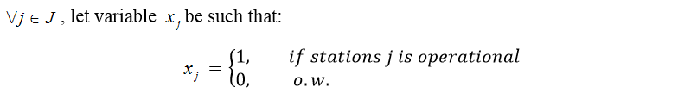
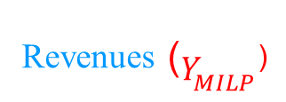
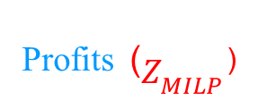
Summary of Proposal - MILP Formulation
Revenues ($Y_{MILP}$)
Profits ($Z_{MILP}$)
Power Trading
Sales
Cost
s.t.
Parameters
Market price in time period t
Retail price in time period t
Cost of opening station j
Cost of opening slots at station j
Decision Variables
Number of slots at station j
Electricity bought from grid by station j in time period t
Electricity sold back to grid from direct charge of station j in time period t
Electricity sold back to grid from battery of station j in time period t
Demand in time period t at station j
Feasible constraint set for the system design variables
Ukesh Chawal
12
Notes:
the main objective of MILP formulation is to maximize overall profit, which is, maximizing revenue benefit from selling electricity both from the direct charge and the battery minus the cost of buying electricity which is power trading component and maximizing the revenue benefit from meeting the demand which is sales component and minimizing the cost of opening an EV station and cost of opening the slots which is cost component.
Here t is the time period of every 15 minutes and j is the number of stations.
Parameters are the known values that we use as an input
Decision variables are unknown values decided by the solver with the help of the parameters and equations.

Slide 13
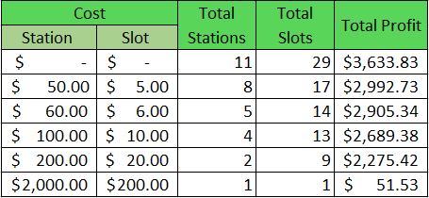
Summary of Proposal - MILP Results
What are the interesting findings and do they make sense?
Findings – Different cost scenarios studied
No operational cost, all the stations are opened.
As the cost increases, the stations start to close and the number of slots and the total profits start to decrease.
Taking practicality in to consideration, a station operation cost of $100 per day plus $10 per slots is considered as the base line.
Ukesh Chawal
13
Notes:
It is observed that with no operational cost, all the stations are opened, and the number of slots opened are 29 and the total profits generated are 3633.83.

Slide 14
Summary of Proposal - MILP Results
Ukesh Chawal
14
Notes:
At a cost of the station and the slots are $0, all 4 main stations have higher number of slots open, Fort Worth, Dallas, Denton and Garland are having a slot count of 6, 5, 4 and 3 respectively.
As the cost reaches 200, the Garland and Denton are closed meaning the cost of opening the slots are higher than the profit they generate.

Slide 15

Summary of Proposal - MILP Limitations
Deterministic model
High computational time (as much as 5 days)
Uses branch-and-bound search algorithm.
Processes all the active nodes in the tree until no more active nodes are available.
Ukesh Chawal
15
Notes:
It is a deterministic model which does not take uncertainty in to consideration.

Slide 16
Presentation Outline
Problem Definition
Dissertation Contribution
Summary of Proposal
Post-Proposal Research Contribution
A Two-Stage Design and Analysis of Computer Experiments (DACE) Approach
Experimental Results
Future Work
Source: https://www.pinterest.com/berat3854/solar/
Ukesh Chawal
16
Notes:
Which leads to the importance of our Post-Proposal Research contribution.

Slide 17
Post-Proposal Research Contribution
Two-stage DACE based ADP approach
Infinite horizon dynamic programming approach to optimize the system of EV charging stations that integrates
First stage - system design problem and
Second stage - dynamic system control problem
Currently there exists no tractable approaches that can globally optimize a general high dimensional infinite horizon stochastic dynamic problem.
When DACE ADP designs and MILP designs are solved using ADP (simulation) , we observed an improvement of approximately 8% in the simulated profits.
Gain understanding between input and output relationship using separable curves.
Ukesh Chawal
17
Notes:
In order to overcome the limitations of MILP, we propose A two-stage Design and Analysis of Computer Experiments (DACE) based Approximate Dynamic Programming (ADP) Approach

Slide 18
First Stage Master
The first stage design problem can be formulated as finding a combination of
c(x) + E_{s}[V(s; x)]
which satisfies the specifications
s.t. x ∈ Γ_{D}
c(x) is the “cost” objective.
V(s; x) is the optimal value function for the second stage dynamic control problem (revenue component).
x is the system design variables.
s is the control problem state variable.
Γ_{D} is the constraint set for the system design variables.
Ukesh Chawal
18
Notes:
The first stage master problem is to solve the EV system problem with the expected revenue obtained from the second stage sub problem.
Here, x is the vector of system design variables, such as the locations of the charging stations and their slots.
s is the vector of initial state variables for the control problem, such as customer demand and power generation from various sources.

Slide 19
Second Stage Dynamic Control
The second stage problem can be formulated mathematically as:
Transition
Constraints
g(s, u, ε; x) is the “cost” objective in each time period of control problem.
V(s; x) is the optimal value function for the dynamic control problem (revenue).
γ is the discount factor on previous value.
st is the control problem state variable at the beginning of time period t .
ut is the second stage decision variables.
εt is the uncertainty in system state dynamics.
x is the system design variables (parameters).
Γ_{C} is the constraint set for the control variables.
h(s_{t} , u_{t} ,ε_{t} ; x) is the state transition equation from time period t to t +1.
Chen et al. (2017)
Ukesh Chawal
19
Notes:
The main objective of this second stage is to solve the dynamic control sub-problem or the revenue component. The optimal value function is minimizing the expected value of the “cost” objective of control problem plus the optimal value function which has a discount factor to represent the future. This is mainly done in Ying’s paper. And this is the optimal value function
Gamma is the discount factor on the previous value. We have used the discount factor of .995 meaning the revenue of this time period is as important as 99.5% as of previous fifteen minute time period. The addition of discount factor helps the function to converge in order to seek steady-state optimality.
In addition, the dynamic control problem is assumed to have stationary system dynamics and many time periods, so that an infinite horizon with continuous-state formulation is appropriate.

Slide 20
DP Formulation for PHEV Charging Stations
Given a system design (x), the control problem has:
State variables in time period t : Initial Battery Level
Sell/Buy Price of Energy
Solar production of each station
Total wind purchased
Total demand of each station
Decision variables in time period t at each station j: Battery level
Wind fractional allocation
Electricity sold back to the grid from the battery / direct charge
Electricity bought from the grid
Demand satisfied from the direct charge / battery
Battery charge level
Chen et al. (2017)
Ukesh Chawal
20
Notes:
We have used his equation to solve our control problem.

Slide 21
Post-Proposal Research Contribution
DACE based MILP approach
Employed our approximate DACE approach in deterministic environment to evaluate its quality.
The results obtained from DACE MILP approach, when compared to MILP, provides near optimal solutions with a loss of less than 1% justifying the effectiveness of the developed methodology.
It reduced the computational time from almost 5 days to less than an hour, making it a much more suitable option for practical use.
Ukesh Chawal
21
Notes:
Since, we cannot evaluate the quality of our approximate DACE approach in stochastic environment, we employed our approximate DACE approach in deterministic environment to evaluate its quality.

Slide 22
Presentation Outline
Problem Definition
Dissertation Contribution
Summary of Proposal
Post-Proposal Research Contribution
A Two-Stage Design and Analysis of Computer Experiments (DACE) Approach
Experimental Results
Future Work
Source: https://www.pinterest.com/berat3854/solar/
Ukesh Chawal
22
Notes:
Now, I will mention about the methodology we used in our post-proposal research which is a two stage…

Slide 23
DACE and ADP Background
ADP is a modeling framework that offers several strategies for tackling the curses of dimensionality in large, multi-period, stochastic optimization problems (Powell 2011).
Curse of dimensionality (CoD):
Exponential growth of the computational and storage requirements as the number of state variables, decision variables and stochastic variables increase especially for high-dimensional problems.
Computationally intractable to solve.
DACE is a computer experiments to approximate the complex system’s output (Sacks 1989).
DACE uses design of experiments (DoE) to sample the state space and statistical modeling to efficiently represent performance measures from a computer model.
Ukesh Chawal
23
Notes:
…..
This results in the problem to be computationally intractable to solve.

Slide 24
Literature Review on DACE based ADP
Chen et al. (1999) proposed a finite horizon ADP algorithm
Orthogonal array (OA) to sample the state space
MARS to approximate the value function to overcome the “curse of dimensionality”.
Chen et al. (2006) summarize this approach as DACE based ADP.
Kulvanitchaiyanunt et al. (2015) studied dynamic control of a system of PHEV charging station utilizing infinite horizon ADP
Linear programming (LP)
Did not consider uncertainty
Chen et al. (2017) applied infinite horizon DACE based ADP considering the uncertainty.
Solved a problem with a random system design points
Control problem (revenue component)
Ukesh Chawal
24
Notes:
Chen et al. (1999) proposed a finite horizon ADP algorithm where they made use of orthogonal array (OA) to sample the state space
and MARS to approximate the value function, aiming to overcome the “curse of dimensionality”. Later on, Chen et al. (2006) summarize this approach as DACE based ADP.
Kulvanitchaiyanunt et al. (2015) studied dynamic control of a system of PHEV charging station utilizing infinite horizon ADP, which makes a decision for each stage through linear programming (LP) without considering uncertainty.
Chen et al. (2017) applied infinite horizon ADP to solve large-scale, high-dimensional, dynamic control system considering the uncertainty.

Slide 25
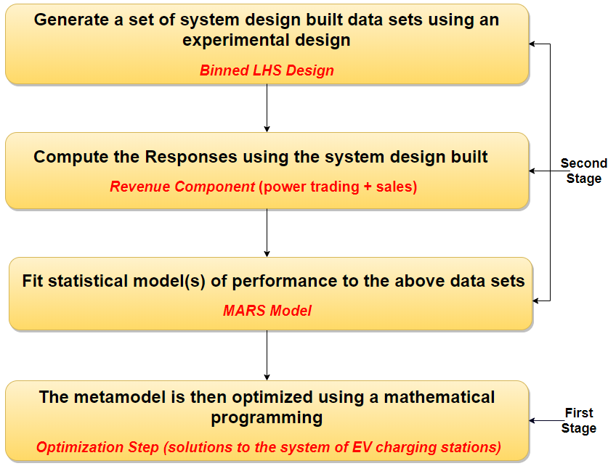
DACE Steps
Metamodel
Ukesh Chawal
25
Notes:
Our DACE steps can be broken down into mainly 4 steps.
1.
2.
3.
4.

Slide 26
System Design – Model Assumptions
To be as realistic as possible
Opening 3 or less stations would not be sufficient to fulfill the demand
Opening 8 or more stations would be more than needed.
Need to create a design where most of the stations opened lies in between 4 to 7 stations.
In other words, almost half of the stations need to be closed majority of the time.
Ukesh Chawal
26

Slide 27

Binned LHS Design
X1 | X2 | X3 | X4 | X5 | X6 | X7 | X8 | X9 | X10 | X11
0.738 | 0.282 | 0.451 | 0.165 | 0.448 | 0.310 | 0.783 | 0.642 | 0.235 | 0.507 | 0.497
0.839 | 0.024 | 0.657 | 0.703 | 0.320 | 0.616 | 0.528 | 0.793 | 0.757 | 0.520 | 0.610
0.032 | 0.178 | 0.772 | 0.737 | 0.518 | 0.396 | 0.017 | 0.296 | 0.023 | 0.493 | 0.440
0.269 | 0.792 | 0.900 | 0.381 | 0.333 | 0.439 | 0.295 | 0.565 | 0.096 | 0.785 | 0.745
0.05263158 | 0
0.10526316 | 0
0.15789474 | 0
0.21052632 | 0
0.26315789 | 0
0.31578947 | 0
0.36842105 | 0
0.42105263 | 0
0.47368421 | 0
0.52631579 | 1
0.57894737 | 2
0.63157895 | 3
0.68421053 | 4
0.73684211 | 5
0.78947368 | 6
0.84210526 | 7
0.89473684 | 8
0.94736842 | 9
1 | 10
The number of stations opened is a binomial random variable where n = 11 and p = .47368421 [B(11,.47)].
Given the station is open, the number of slots that an open station will have, is a discrete uniform distribution with values between 1 and 10.
Ukesh Chawal
27
Notes:
To achieve that objective, we used LHS to generate the design points on MATLAB.
The fractional values obtained from LHS design are then replaced to values between 0 – 10, indicating the number of slots.
We decided to create 19 bins that are equally spaced. The first 9 bins i.e. almost half are assigned to zero slots to match our model assumption, and the rest 10 bins are equally distributed from 1 to 10 slots.

Slide 28
X1 | X2 | X3 | X4 | X5 | X6 | X7 | X8 | X9 | X10 | X11
0.738 | 0.282 | 0.451 | 0.165 | 0.448 | 0.310 | 0.783 | 0.642 | 0.235 | 0.507 | 0.497
0.839 | 0.024 | 0.657 | 0.703 | 0.320 | 0.616 | 0.528 | 0.793 | 0.757 | 0.520 | 0.610
0.032 | 0.178 | 0.772 | 0.737 | 0.518 | 0.396 | 0.017 | 0.296 | 0.023 | 0.493 | 0.440
0.269 | 0.792 | 0.900 | 0.381 | 0.333 | 0.439 | 0.295 | 0.565 | 0.096 | 0.785 | 0.745
X1 | X2 | X3 | X4 | X5 | X6 | X7 | X8 | X9 | X10 | X11
6 | 0 | 0 | 0 | 0 | 0 | 6 | 4 | 0 | 1 | 1
7 | 0 | 4 | 5 | 0 | 3 | 2 | 7 | 6 | 1 | 3
0 | 0 | 6 | 6 | 1 | 0 | 0 | 0 | 0 | 1 | 0
0 | 7 | 9 | 0 | 0 | 0 | 0 | 2 | 0 | 6 | 6
Ukesh Chawal
28
Notes:
..........
In this way, we create a design where most of the stations opened lies in between 4 to 7 stations to match our model assumption.

Slide 29
System Design
Binned LHS design consists of 100 training dataset and 75 testing dataset. The notation for the system design would be as follows:
where, N = 175
Eighty percent of our observations in the sample space have 4-7 stations opened.
Ukesh Chawal
29
Notes:
In this way, we developed a binned LHS design which consists of ….
Binned Latin Hypercube design generates a binomial distribution which matches our requirement.

Slide 30
DACE Steps
Metamodel
Ukesh Chawal
30

Slide 31
Compute responses solving control problem
Design of experimental as a input data set
Control Problem
solve
X1 | X2 | X3 | X4 | X5 | X6 | X7 | X8 | X9 | X10 | X11
6 | 0 | 0 | 0 | 0 | 0 | 6 | 4 | 0 | 1 | 1
7 | 0 | 4 | 5 | 0 | 3 | 2 | 7 | 6 | 1 | 3
0 | 0 | 0 | 0 | 0 | 0 | 0 | 0 | 8 | 4 | 0
1 | 6 | 2 | 3 | 0 | 7 | 0 | 8 | 8 | 9 | 3
0 | 4 | 3 | 10 | 8 | 7 | 0 | 0 | 3 | 9 | 6
0 | 5 | 0 | 0 | 2 | 10 | 3 | 0 | 5 | 8 | 4
7 | 2 | 1 | 0 | 10 | 0 | 0 | 0 | 9 | 3 | 1
10 | 6 | 9 | 6 | 10 | 1 | 9 | 2 | 0 | 9 | 7
3 | 0 | 0 | 0 | 0 | 3 | 0 | 0 | 0 | 0 | 10
0 | 0 | 0 | 2 | 0 | 8 | 1 | 0 | 5 | 0 | 0
0 | 0 | 4 | 0 | 0 | 0 | 2 | 0 | 0 | 0 | 6
2 | 0 | 0 | 0 | 0 | 0 | 0 | 4 | 4 | 1 | 0
0 | 7 | 10 | 0 | 0 | 10 | 3 | 5 | 0 | 5 | 0
0 | 0 | 5 | 7 | 1 | 10 | 8 | 10 | 10 | 0 | 0
2 | 2 | 0 | 0 | 0 | 1 | 0 | 10 | 0 | 0 | 0
0 | 0 | 2 | 0 | 0 | 7 | 0 | 0 | 4 | 0 | 0
4 | 0 | 8 | 3 | 0 | 10 | 0 | 0 | 0 | 0 | 0
0 | 7 | 2 | 7 | 0 | 5 | 5 | 9 | 6 | 7 | 0
0 | 0 | 6 | 6 | 1 | 0 | 0 | 0 | 0 | 1 | 0
0 | 7 | 9 | 0 | 0 | 0 | 0 | 2 | 0 | 6 | 6
Revenues
Y¹
Y²
Y³
Y⁴
Y⁵
Y⁶
Y⁷
Y⁸
Y⁹
Y¹⁰
Y¹¹
Y¹²
Y¹³
Y¹⁴
Y¹⁵
Y¹⁶
Ukesh Chawal
31

Slide 32

Compute responses solving control problem
in stochastic environment
Determine the state variables and decision variables.
The state and decision variables at each stations are then evaluated in a stochastic environment, to estimate the optimal ADP policy as described in Chen et al. (2017).
Simulate the control policy to obtain revenues while also taking into consideration demand at each stations. The demand profile used is based on Kulvanitchaiyanunt et al. (2015) .
The revenues ( ) obtained represent Es[V(s; x)] component of the equation mentioned previously in the first stage master problem:
c(x) + Es[V(s; x)]
$Y_{DA}$
Ukesh Chawal
32

Slide 33

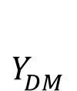
Compute responses solving control problem
in deterministic environment
Determine the parameters and decision variables.
The parameters and decision variables at each stations are then evaluated in a deterministic environment, to compute the revenues solving the control problem.
The revenues ( ) obtained represent the power trading and the sales component of the MILP formulation:
$Y_{DM}$
Ukesh Chawal
33

Slide 34
DACE Steps
Metamodel
Ukesh Chawal
34

Slide 35
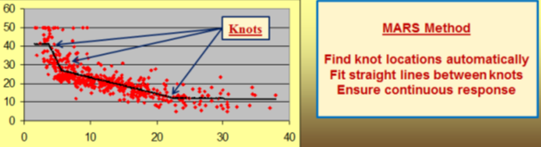
Multivariate Adaptive Regression Splines
MARS, introduced by (Friedman, 1991), is essentially a linear model with a forward stepwise algorithm to select model terms followed by a backward procedure to prune the model.
It fits basis functions (hinge function) composed of single or products of truncated piecewise-linear functions using linear least squares estimation.
The approximation bends to model curvature at "knot" locations.
Source: https://www.salford-systems.com/products/mars
_{Ukesh Chawal}
35
Notes:
Because curvature was apparent in the scatter plots, MARS algorithm was used to identify piecewise-linear basis functions.The reason why we include BF (hinge or piecewise linear function) in the model because we have a preliminary model without BF before and it contains non-constant variance (the curvature on the residual plot).

Slide 36
Fit statistical model of performance
Predictors: Nsj = Integer variables representing number of slots at station j, where j = 1, …, 11
BF = Regression spline basis function
Coefficients: β = Regression coefficients or least square estimators
Response: Predicted revenue obtained using MARS
_{Ukesh Chawal}
36
Notes:
The reason why we include BF (hinge or piecewise linear function) in the model because we have a preliminary model without BF before and it contains non-constant variance (the curvature on the residual plot).
BF is obtained by Multivariate Adaptive Regression Splines (from Salford system modeler) to present the basis function with 2 ways interaction.
MARS, introduced in Friedman (1991), is essentially a linear model with a forward stepwise algorithm to select model terms followed by a backward procedure to prune the model. It fits basis functions composed of single or products of truncated linear functions, with optional smoothing, using linear least squares estimation. Because curvature was apparent in the scatter plots, MARS algorithm was used to identify piecewise-linear basis functions

Slide 37
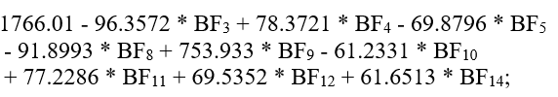
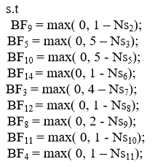
Fit statistical model of performance
9. Denton
8. Plano
10. Greenville
7.Garland
4. Rockwall
3. Fort Worth
5. Dallas
2. Heartland
11. Godley
1. Palmer
6. Waxahachie
9 basis functions should be the best size of the fitted model.
Stations 1 (Palmer) and 4 (Rockwall) are not important.
Testing R² is 0.944
_{Ukesh Chawal}
37
Notes:
We used Salford System to generate the MARS model. Here, we can see a forward stepwise algorithm selected 14 basis functions while a backward procedure pruned 5 basis function indicating 9 basis functions should be the best size of the fitted model. Also, In this study, we observe that non interaction is better than interaction since there is not much of a demand shift because of the stations being far apart from each other. Power trading component in a control problem is a much larger dominating factor as compared to pre allocating wind across the different stations.
…….
The prediction accuracy of the constructed metamodel is 94.4%.

Slide 38
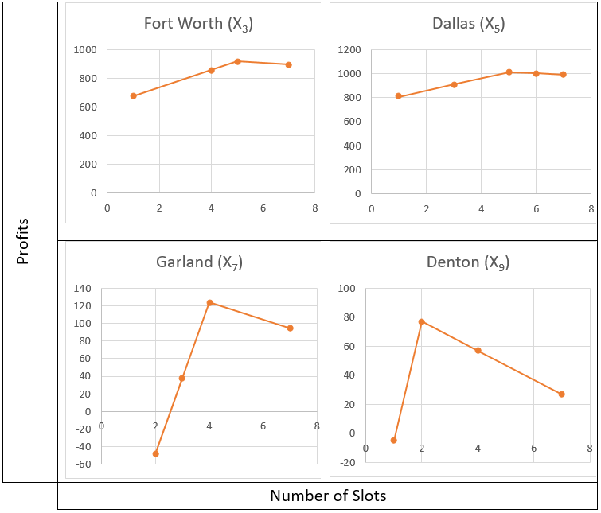
Separable Case
Number of slots and profits per stations
DACE helps us to understand the relationship between number of slots to be opened (input) and the profit generated (output).
Ukesh Chawal
38
Notes:
Ananlyzing Mars equation with individual stations in excel, the obtained best number of slots for Fort Worth, Dallas, Garland and Denton are 5, 5 ,4 and 2 respectively.
Gain understanding between input and output relationship using separable curves.

Slide 39
DACE Steps
Metamodel
Ukesh Chawal
39

Slide 40
Optimizing EV System using DACE ADP
Solve the generated MARS equation in a LP Solver
Obtain the optimal system design
The obtained system design are then substituted in the control problem equation (Step 2 of DACE steps) to generate the true revenue ( ).
The true profit is then calculated by subtracting the cost component
_{Ukesh Chawal}
40
Notes:
……..
Thus, this obtained $Z_{DA}$ and $x^{∗}, {Ns}^{∗}$ are the solutions to our first stage EV system master problem.

Slide 41
Optimizing System Design using DACE MILP
Solve the generated MARS equation in a LP Solver
Obtain the optimal system design
The obtained system design are then substituted in the control problem equation (Step 2 of DACE steps) to generate the true revenue ( ).
The true profit is then calculated by subtracting the cost component
Ukesh Chawal
41

Slide 42
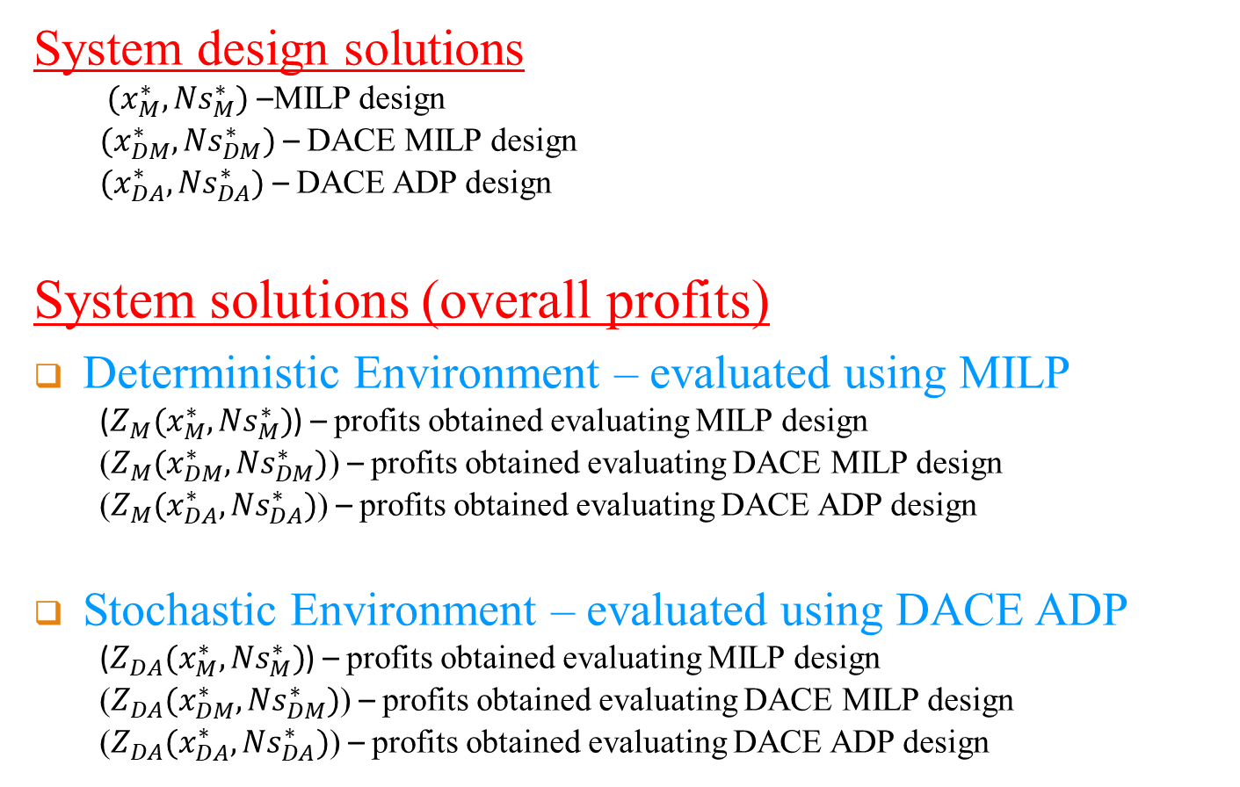
First Stage Solutions
System design solutions
$(x_{M}^{∗},{Ns}_{M}^{∗})$ –MILP design
$(x_{DM}^{∗},{Ns}_{DM}^{∗})$ – DACE MILP design
$(x_{DA}^{∗},{Ns}_{DA}^{∗})$ – DACE ADP design
System solutions (overall profits)
Deterministic Environment – evaluated using MILP
($Z_{M}(x_{M}^{∗},{Ns}_{M}^{∗})$) – profits obtained evaluating MILP design
($Z_{M}(x_{DM}^{∗},{Ns}_{DM}^{∗})$) – profits obtained evaluating DACE MILP design
($Z_{M}(x_{DA}^{∗},{Ns}_{DA}^{∗})$) – profits obtained evaluating DACE ADP design
Stochastic Environment – evaluated using DACE ADP
($Z_{DA}(x_{M}^{∗},{Ns}_{M}^{∗})$) – profits obtained evaluating MILP design
($Z_{DA}(x_{DM}^{∗},{Ns}_{DM}^{∗})$) – profits obtained evaluating DACE MILP design
($Z_{DA}(x_{DA}^{∗},{Ns}_{DA}^{∗})$) – profits obtained evaluating DACE ADP design
Ukesh Chawal
42

Slide 43
Presentation Outline
Problem Definition
Dissertation Contribution
Summary of Proposal
Post-Proposal Research Contribution
A Two-Stage Design and Analysis of Computer Experiments (DACE) Approach
Experimental Results
Future Work
Source: https://www.pinterest.com/berat3854/solar/
Ukesh Chawal
43
Notes:
Now I will present the experimental results.

Slide 44
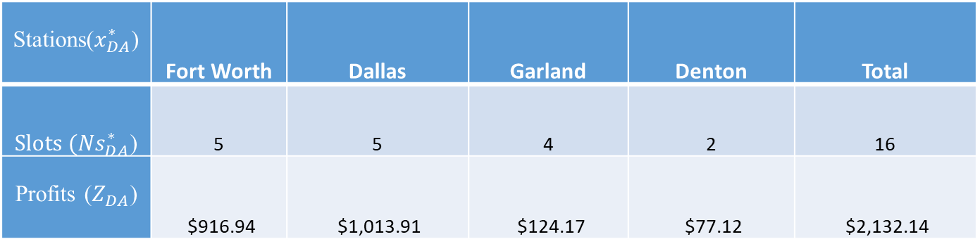
DACE based ADP Results (Simulation)
Number of slots and profits generated per stations
Stations($x_{DA}^{∗}$) | Fort Worth | Dallas | Garland | Denton | Total
${Slots (Ns}_{DA}^{∗}$) | 5 | 5 | 4 | 2 | 16
Profits ($Z_{DA}$) | $916.94 | $1,013.91 | $124.17 | $77.12 | $2,132.14
Ukesh Chawal
44
Notes:
……
The profit distribution between Dallas, Fort Worth, Garland and Denton are 47%, 43%, 6% and 4% respectively indicating Dallas to be the most profitable station, followed by Fort Worth, Garland, and Denton.

Slide 45
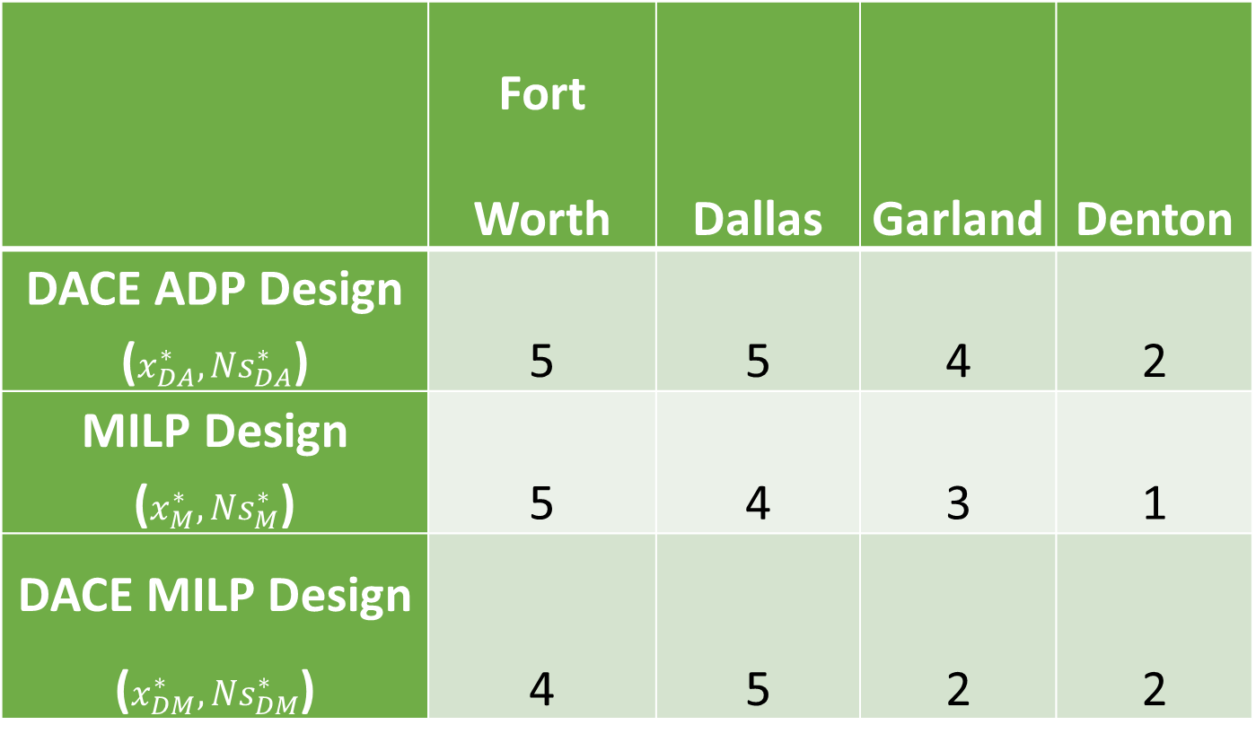
Designs Comparison between all the methods
 | Fort Worth | Dallas | Garland | Denton
DACE ADP Design ($x_{DA}^{∗},{Ns}_{DA}^{∗}$) | 5 | 5 | 4 | 2
MILP Design ($x_{M}^{∗},{Ns}_{M}^{∗}$) | 5 | 4 | 3 | 1
DACE MILP Design ($x_{DM}^{∗},{Ns}_{DM}^{∗}$) | 4 | 5 | 2 | 2
Ukesh Chawal
45
Notes:
Same four stations are the ones to be opened.
As mentioned earlier, the best known ADP design built are Dallas, Fort Worth, Garland and Denton with their number of slots being opened are 5, 5, 4 and 2, respectively whereas the best known MILP design built are Forth Worth, Dallas, Garland and Denton with their number of slots being opened are 5, 4, 3 and 1, respectively where as DACE MILP has ….

Slide 46
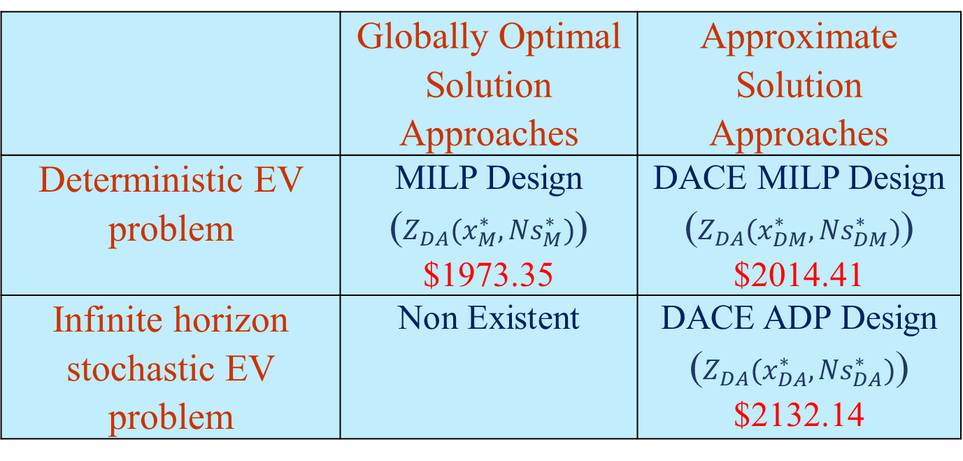
Simulated Profits under Stochastic Environment
 | Globally Optimal Solution Approaches | Approximate Solution Approaches
Deterministic EV problem | MILP Design ($Z_{DA}(x_{M}^{∗},{Ns}_{M}^{∗})$) ​$1973.35 | DACE MILP Design ($Z_{DA}(x_{DM}^{∗},{Ns}_{DM}^{∗})$) $2014.41
Infinite horizon stochastic EV problem | Non Existent | DACE ADP Design ($Z_{DA}(x_{DA}^{∗},{Ns}_{DA}^{∗})$) $2132.14
An improvement 8.06% in the solution, indicating when uncertainty is considered, DACE ADP design provides the better solution.
Ukesh Chawal
46
Notes:
When DACE ADP design and MILP design are solved using ADP approach, the profit obtained is $2132.14 and $1973.35 respectively. We can see an improvement of approximately 8% in the solution obtained from ADP design compared to that of MILP design indicating when uncertainty is considered, DACE ADP design provides the better solution.
An improvement 8.06% in the solution, indicating when uncertainty is considered, DACE ADP design provides the better solution.

Slide 47
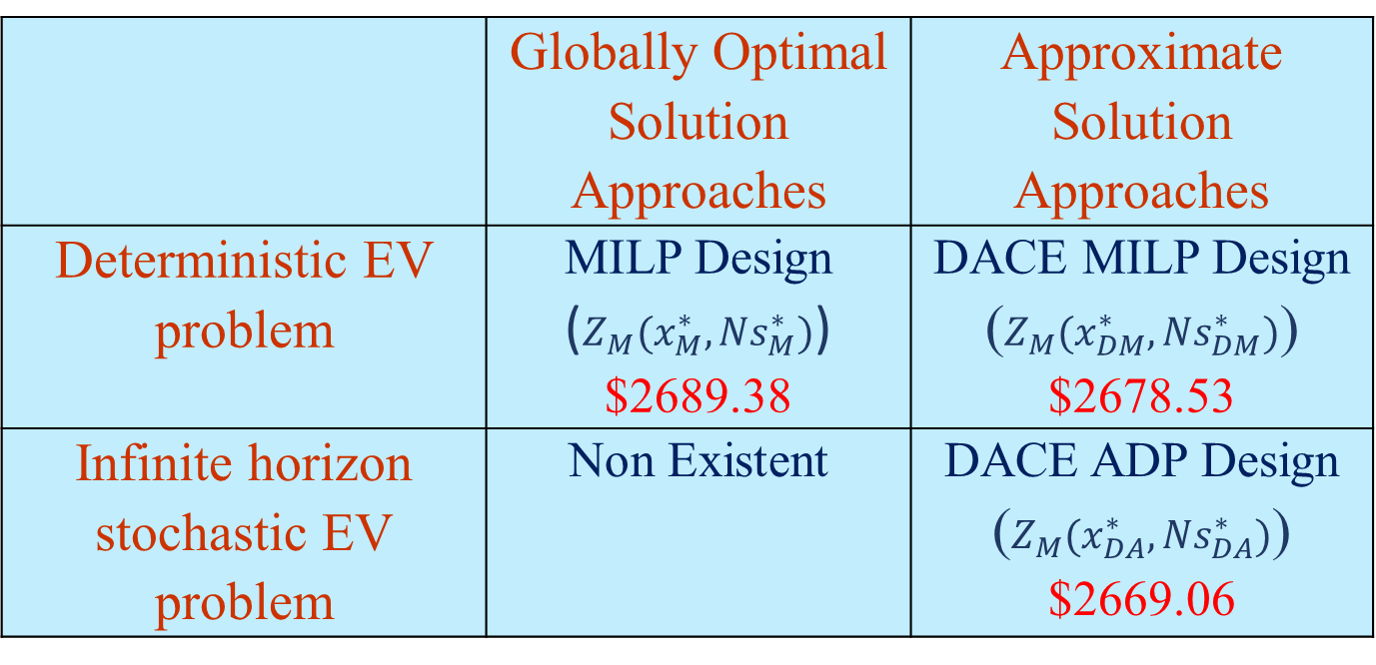
Profits under Deterministic Environment
 | Globally Optimal Solution Approaches | Approximate Solution Approaches
Deterministic EV problem | MILP Design ($Z_{M}(x_{M}^{∗},{Ns}_{M}^{∗})$) ​$2689.38 | DACE MILP Design ($Z_{M}(x_{DM}^{∗},{Ns}_{DM}^{∗})$) $2678.53
Infinite horizon stochastic EV problem | Non Existent | DACE ADP Design ($Z_{M}(x_{DA}^{∗},{Ns}_{DA}^{∗})$) $2669.06
The results provides near optimal solutions with a loss of 0.41% justifying the effectiveness of the DACE framework.
DACE is a solution approach that provides a near optimal solution.
Ukesh Chawal
47
Notes:
The results provides near optimal solutions with a loss of 0.41% justifying the effectiveness of the developed DACE framework.
Thus, we can argue that DACE approach is not only the solution approach but probably near optimal solution approach.

Slide 48
CPU Time Comparisons
 | Globally Optimal Solution Approaches | Approximate Solution Approaches
Deterministic EV problem | MILP Design ​4 days 23 hours | DACE MILP Design 54 min 40 sec
Infinite horizon stochastic EV problem | Non Existent | DACE ADP Design 4 days 3 hours
Furthermore, it reduces the computational time from 4 days and 23 hours to 54 min 40 sec, making it a much more suitable option for practical use.
Ukesh Chawal
48

Slide 49
Presentation Outline
Problem Definition
Dissertation Contribution
Summary of Proposal
Post-Proposal Research Contribution
A Two-Stage Design and Analysis of Computer Experiments (DACE) Approach
Experimental Results
Future Work
Source: https://www.pinterest.com/berat3854/solar/
Ukesh Chawal
49
Notes:
Now, I will mention about the future work.

Slide 50
Future Work
Alternatives to ADP to solve infinite horizon stochastic problem can be explored.
Instead of MARS, other statistical models that best approximates the outputs can be investigated.
Alternative design of experiment methods as compared to LHS can also be employed and tested.
Work on smart city application.
Ukesh Chawal
50

Slide 51
Acknowledgement
COSMOSians (Ying, Raghavendra, Mewan, Aditya, Feng, Nilabh, Shirish, Amith, Gazi, Khan, Rahil, Zahra, Hadis, Ashkan)
Graduate Advisor: Dr. Sheik Imrhan
Committee: Dr. John Priest, Dr. Wei-Jen Lee, Dr. Aera LeBoulluec
Supervising Professors: Dr. Jay Rosenberger, Dr. Victoria Chen
Ukesh Chawal
51
Notes:
Moreover, I would like to thank my friends for assisting me one or the other way. Ying, Raghavendra, Mewan and Aditya helped me in writing papers.
Dr. Imrhan - Class registration, figure out master degree, complete the degree plan successfully
My committee members for the support, guidance and valuable comments for the improvement of my research.
I would like to express my sincere appreciation to my supervising professors, Dr. Jay Rosenberger and Dr. Victoria Chen, for their guidance, support and enthusiastic encouragement throughout this research. I appreciate them for providing me with these very interesting projects. They were always there to provide necessary assistance and academic resources. Dr, Chen helped me with the funding for Summer 2016. I really appreciate everything that you have done to me.

Slide 52
References
"Solar." Pinterest. N.p., n.d. Web. 02 May 2017. [Online]. Available: https://www.pinterest.com/berat3854/solar/
Chen, V. C. P., Ruppert, D., Shoemaker, C. A. Applying experimental design and regression splines to high-dimensional continuous-state stochastic dynamic programming. Operations Research, 47(1): 38-53, 1999.
Chen, V. C., Tsui, K. L., Barton, R. R., & Meckesheimer, M. (2006). A review on design, modeling and applications of computer experiments. IIE transactions, 38(4), 273-291.
Chen, Y., Liu, F., Kulvanitchaiyanunt, A., Chen, V. C. P., Rosenberger, J., Wang, S. (2017). Infinite Horizon Approximate Dynamic Programming Using Computer Experiments. COSMOS 17-02, University of Texas at Arlington.
Friedman, J. H. (1991). Multivariate adaptive regression splines. The annals of statistics, 1-67.
Guo, Y., Xiong, J., Xu, S., & Su, W. (2016). Two-stage economic operation of microgrid-like electric vehicle parking deck. IEEE Transactions on Smart Grid, 7(3), 1703-1712.
Kulvanitchaiyanunt, A., Chen, V. C., Rosenberger, J., Sarikprueck, P., & Lee, W. J. (2015, October). A linear program for system level control of regional PHEV charging stations. In Industry Applications Society Annual Meeting, 2015 IEEE (pp. 1-8). IEEE.
Lulli, G., & Sen, S. (2004). A branch-and-price algorithm for multistage stochastic integer programming with application to stochastic batch-sizing problems. Management Science, 50(6), 786-796.
Pan, F., Bent, R., Berscheid, A., & Izraelevitz, D. (2010, October). Locating PHEV exchange stations in V2G. In Smart Grid Communications (SmartGridComm), 2010 First IEEE International Conference on (pp. 173-178). IEEE.
Pilla, V. L., Rosenberger, J. M., Chen, V. C., & Smith, B. (2008). A statistical computer experiments approach to airline fleet assignment. IIE transactions, 40(5), 524-537.
Powell, W. B. (2011). Approximating value functions. Approximate Dynamic Programming: Solving the Curses of Dimensionality, 225-269.
Sacks, J., Welch, W. J., Mitchell, T. J., & Wynn, H. P. (1989). Design and analysis of computer experiments. Statistical science, 409-423.
Ukesh Chawal
52

Slide 53

THANK YOU!
Questions or Comments?
Ukesh Chawal
53

Slide 54
Backup Slides
Ukesh Chawal
54

Slide 55
Introduction
The transportation sector is the second largest producer of carbon dioxide emission in the U.S in 2015 (EPA)
U.S. government pledged to reduce greenhouse gas emissions by 17%, by 2020
Electricity is a clean energy source which can be generated using multiple renewable energy sources (solar, wind, etc. )
Volvo models will go all electric or hybrid starting in 2019
Ukesh Chawal
55
Notes:
EPA – Environmental Protection Agency
that leads to the importance of getting easy access to charging facility which is the main goal of this research.

Slide 56
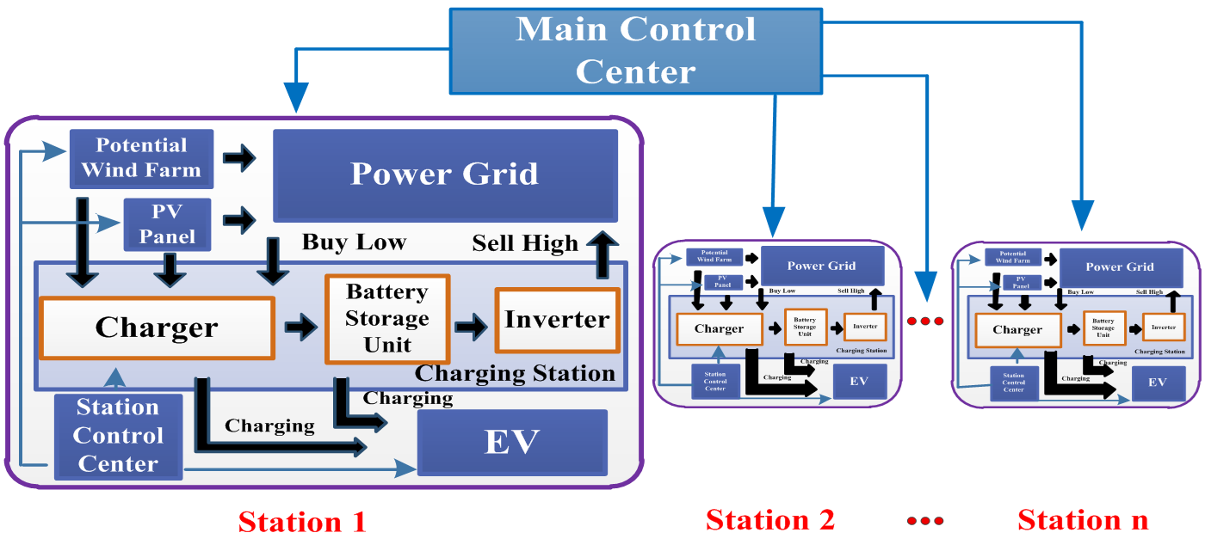
System Control Layout
Ukesh Chawal
56
Notes:
-Initially we obtain energy from wind and solar energy generation
-stored in the charger
-store excessive energy in the battery storage unit.
-satisfy the demand
-if the energy insufficient bought from the external power grid
-excess energy sold back to the external power grid
- The idea is to buy when the cost low and sell when it is high.

Slide 57
Point of Interest – DFW
9. Denton
8. Plano
Number of Potential Stations = 11
Number of Hotspots (cities) = 140
10. Greenville
7.Garland
4. Rockwall
3. Fort Worth
5. Dallas
2. Heartland
11. Godley
1. Palmer
6. Waxahachie
Ukesh Chawal
57

Slide 58

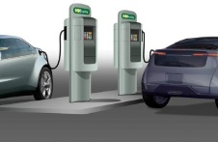
System Design Behavior
A network of charging stations
Charging Stations
Hotspots
- Location of electric charging stations
- Assignment of demand hotspots to the charging stations
Ukesh Chawal
58

Slide 59
DFW Case Study
Historical data (2012)
Wind Energy – Electric Reliability Council of Texas (ERCOT).
Solar Energy – National Solar Radiation Database.
Market price – ERCOT, updates data every 15 min.
Retail price (2014) – 10.24 cents/kWh. Energy Information Administration
Battery type: NaS (Sodium Sulphur)
Battery charge rate (cr): 600 kW /slot
Discharge rate (dc): 75 kW/slot
Maximum Battery Capacity: 3.6 MWh/slot
Minimum Battery Capacity: 720 kWh/slot
Ukesh Chawal
59
Notes:
NAS due to its high efficiency and long life ( 4500 Cycles)
Other battery type Li-ion, NiMH- Nickel Metal Hydride, Lead acid Flooded-
Maximum Battery Capacity considered at 2 days reserve for 1 slot is 3.6 MWh/slot
Minimum level of battery capacity is 20% of maximum battery capacity for 1 slot is 720 kWh/slot

Slide 60
DFW Case Study - Assumptions
Maximum permissible distance between station and hotspot is 20 miles.
Cost of opening a slot is 10% of cost of opening a station.
The maximum number of slots to be opened is 10.
Only 50% of customers are willing to wait in a queue in a given time period of 15- min.
Sets
J set of potential stations locations indexed by j
I set of demand hot spots indexed by i
T set of time periods of 15 minutes in a day indexed by t
Ukesh Chawal
60
Notes:
NAS due to its high efficiency and long life ( 4500 Cycles)
Other battery type Li-ion, NiMH- Nickel Metal Hydride, Lead acid Flooded-
Maximum Battery Capacity considered at 2 days reserve for 1 slot is 3.6 MWh/slot
Minimum level of battery capacity is 20% of maximum battery capacity for 1 slot is 720 kWh/slot

Slide 61
MILP Model
Mixed Integer Linear Programming deals with the problems of maximization or minimization of a function of many variables subject to:
Inequality and equality constraints and
Integrality restrictions on some variables
Major applications
Assignment Problem
Matching Problem
Set-Covering, Set-Packing, and Set-Partitioning Problems
Facility Location Problem
Network Flow Problems
Traveling Salesman Problem
Piecewise Linear Function
Machine Scheduling Problem
Ukesh Chawal
61

Slide 62
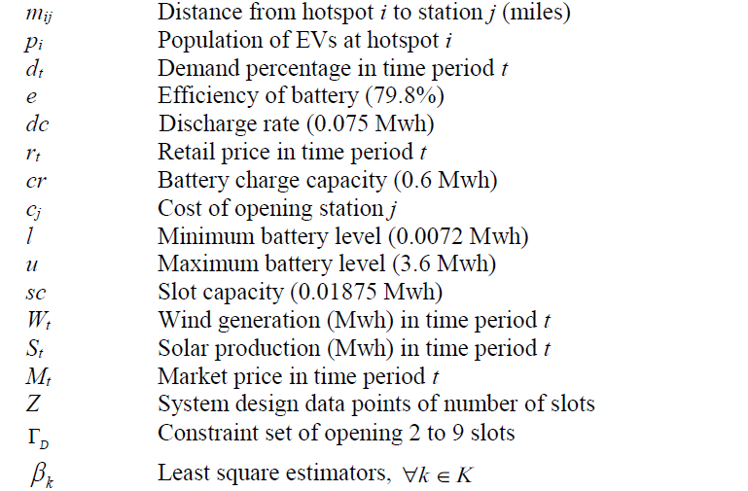
Nomenclature
Parameters
Ukesh Chawal
62

Slide 63
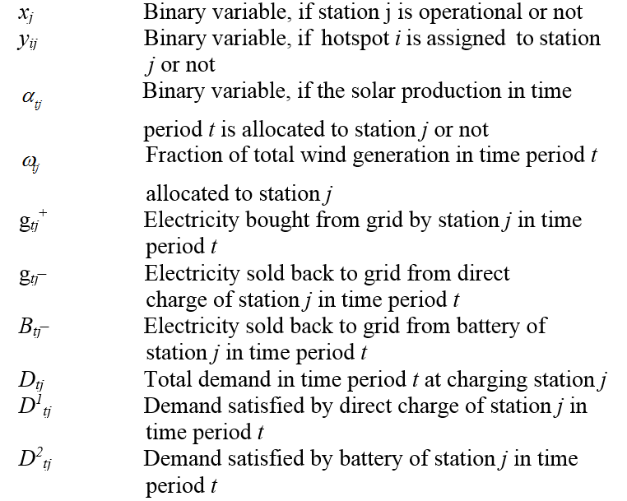
Nomenclature
Variables
Ukesh Chawal
63

Slide 64
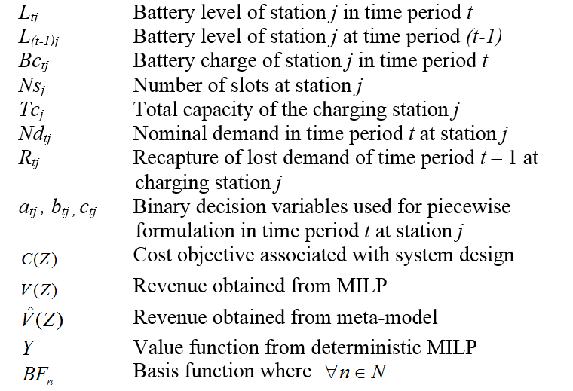
Nomenclature
Variables
Ukesh Chawal
64

Slide 65
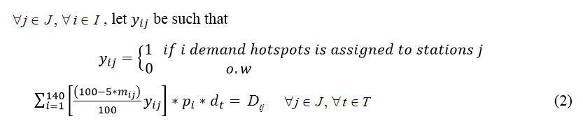

MILP Formulation
Parameters
Population of EVs at hotspot i
Demand percentage in time period t
Distance from hotspot i to station j (miles)
Decision Variables
Total demand in time period t at charging station j
Ukesh Chawal
65
Notes:
The total demand in time period t at charging station j is the product of the distance function which is the percentage of the demand hotspots i assigned to station j with the population of hotspots i and the general demand percentage in time periods t.
The constraints in equation (4) ensure that all the hotspots need not be served by the station j.

Slide 66
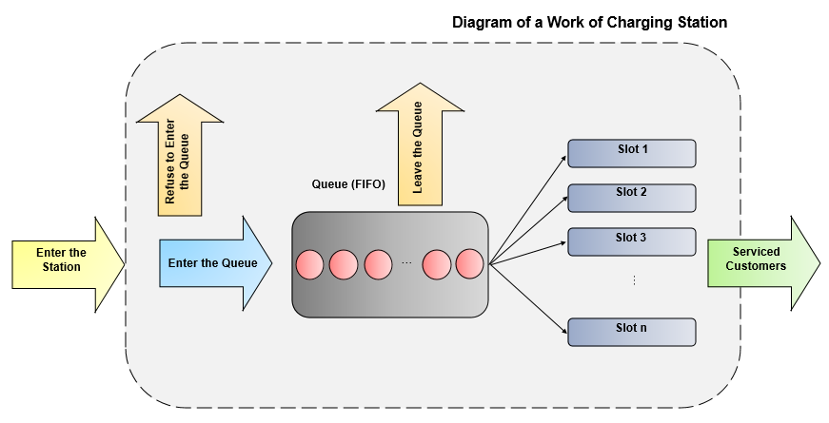



Demand Loss Model
Decision Variables
Total capacity of the charging station j
Recapture of the demand willing to wait in queue in period t at charging station j
Ukesh Chawal
66

Slide 67

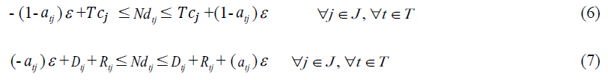
Demand Loss Model – Piecewise Formulation
Parameters
sc Slot capacity (0.01875 Mwh)
Upper bound (very large number, + ∞)
Decision Variables
Total capacity of the charging station j
Recapture of the demand willing to wait in queue in period t at charging station j
Example: Tc =10
D1 = 4, R1 = 4
ND1 = 8
D2 = 8, R2 = 4
ND2= 10
Loss demand = 1
R = 1
Ukesh Chawal
67
Notes:
The constraints in equation (6) and (7) is the piecewise linear formulation ensuring that if the sum of the total demand and the recapture of the loss demand in time period t at station j is equal or more than total capacity of the station j, then total nominal demand in time period t at station j is equal to the total capacity of the charging station j. Otherwise, it is equal to the sum of the total demand and the recapture of the loss demand in time period t at station j. Also, is the upper bound (very large number, + ∞).

Slide 68
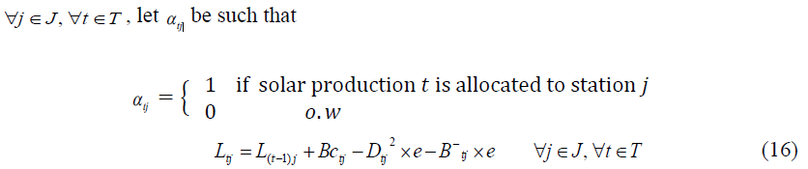
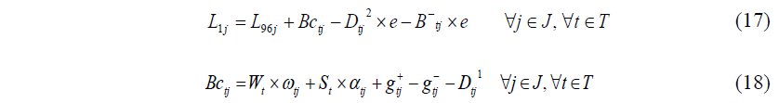


MILP Formulation
Ukesh Chawal
68
Notes:
The set of energy balance constraints include the battery level transition as equation (16), the energy balance for the battery charge as equation (18). Moreover, the constraints in equation (17) ensure the battery level at the first stage is calculated using battery level transition equation and the battery level at the previous stage (96 stage).
The constraints in equation (19) ensure that the electricity sold back to the grid from the direct charge of station j in time period t should be less than or equal to the sum of the total wind purchased by station j in time period t, the solar production of station j in time period t and the electricity bought from the grid by station j in time period t. Similarly, the constraints in equation (20) ensure that the electricity bought from the grid by station j in time period t should be less than the total nominal demand in time period t at charging station j.
The constraints in equation (21) ensures that the sum of the electricity sold back to the grid from the battery of station j in time period t and the demand satisfied by the battery of station j in time period t cannot be higher than the product of discharge rate and storage efficiency of station j. Similarly, the constraints in equation (22) ensures that the battery charge of station j in time period t should be within the battery charge capacity. And, the constraints in equation (23) ensures that the battery level boundary is between the minimum battery level and maximum battery level for each station. Moreover, all 3 equations also ensure that it is only possible when the station is operational.

Slide 69

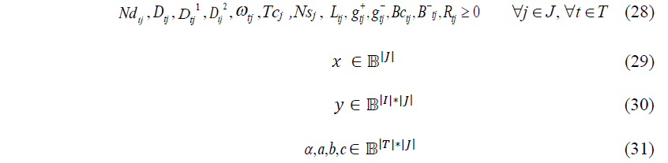
MILP Formulation
Ukesh Chawal
69
Notes:
The fraction of wind allocation, constraint in equation (24), is constructed to allocate the total wind production to each station.
The constraints in equations (25) and (26) ensure that the total wind purchased by station j in time period t, and the solar production of station j in time period t are not possible if the stations are not operational.
The constraints in equation (27) ensure the assumption that the maximum number of slots opened per charging station j is ten, and these are not possible if the stations are not operational.
The constraints in equations (28), (29) , (30) and (31) ensure that all these variables are positive numbers, x is binary with dimension of j , y is binary with dimension of i times j and are binaries with dimension of t times j.
3.1.3 Flowchart of Proposed MILP Model

Slide 70
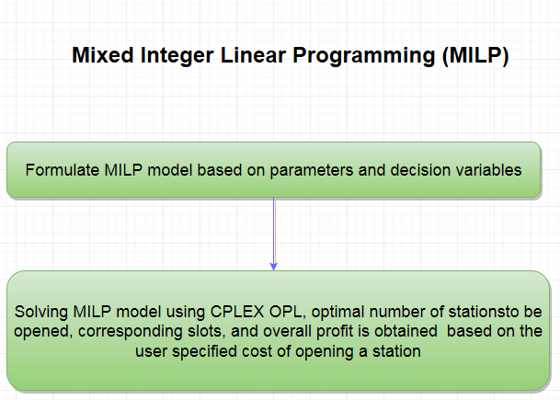
Flowchart of MILP Model
Ukesh Chawal
70

Slide 71
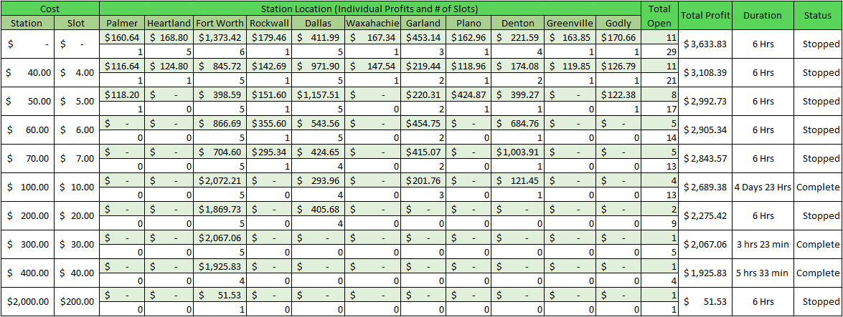
MILP Results
What are the interesting findings and do they make sense?
Ukesh Chawal
71
Notes:
It is observed that with no operational cost, all the stations are opened, and the number of slots opened and the total profits generated are the highest compared to the other scenarios, which makes a very practical sense in the real world. As the cost keeps increasing, it has been noticed that the stations start to close and the number of slots start to decrease with their respective stations. However, when increasing the cost from $70 to $100, the number of slots in Garland increased from 2 to 3, the reason being, it now captures the demand from Rockwall (closed for $100), since it is the closest open station.
Taking in to consideration practicality, a station cost of $100 is considered as the base line. Using a cost of $100, it took 4 days and 23 hours of processing time to provide an optimal solution. The total profit of the optimal solution is $2689.38. For each of these locations the number of slots being opened are 5, 4, 3 and 1, respectively.
It has been observed that the solution (best integer) is normally obtained between 20 minutes to 1 hour 55 minutes, and to prove this solution is the global optimal, using branch and cut algorithm, it takes close to 5 days. Given that the processing time normally takes 5 days for every scenario and the solution is found before 2 hours, a limit of 6 hours is placed on the scenario which was considered “practical”.

Slide 72
MILP Results - Demand Distribution
What are the interesting findings and do they make sense?
Ukesh Chawal
72
Notes:
It can be observed that the total demand distribution for Fort Worth is the highest, Dallas is the second highest, followed by Garland, and Denton, respectively. Moreover, it is observed that the demand is lowest from time period 12 to 20 i.e. from 3 am to 5 am and then it gradually increases and has highest demand between time periods 52 to 68 i.e. from 1 pm to 5 pm. And subsequently, the demand decreases which makes practical sense in the real world.

Slide 73
DACE based system design optimization approach
A computer experiments to approximate the complex system’s output by developing a two stage framework – meta-model.
select an experimental design
fit a statistical model
A mathematical programming technique is used to optimize the meta-model.
The results provides near optimal solutions and significantly reduces the computation time
Ukesh Chawal
73

Slide 74
Literature Review
DACE - high-dimensional continuous-state stochastic dynamic programming [Chen (1999), (2006)]
DACE - Infinite horizon dynamic programming [Kulvanitchaiyanunt (2014)]
DACE based Approximate Dynamic Programming
Control Problem (Power trading and Sales component)
Ukesh Chawal
74
Notes:
The approaches for the two primary tasks of metamodeling are described: (i) selecting an experimental design; and (ii) fitting a statistical model.

Slide 75
Experiments – Case Study
Binned LHS Design – 250 training data sets, 75 testing data sets
MATLAB
Revenue Component (Power Trading and Sales)
CPLEX OPL
MARS Model – (interaction and non-interaction)
MATLAB ARESLAB
Salford Predictive Modeler
System Design (number of stations and their corresponding slots)
CPLEX CP (constraint programming)
AMPL COUENNE
AMPL MINOS
Ukesh Chawal
75
Notes:
The approaches for the two primary tasks of metamodeling are described: (i) selecting an experimental design; and (ii) fitting a statistical model.

Slide 76
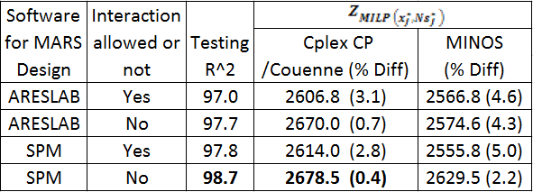

Comparisons of the DACE MILP objective solutions
DACE Results – Control Problem
DACE
Findings
The results provides near optimal solutions with high fidelity.
Ukesh Chawal
76

Slide 77
DACE Results – Control Problem
Findings - Non interaction better than Interaction
In this study, it is observed that non interaction is better than interaction since there is not much of a demand shift because of the stations being far apart from each other.
Power trading component in a control problem is a much larger dominating factor as compared to pre allocating wind across the different stations.
Ukesh Chawal
77

Slide 78
System Design Built (MILP vs. DACE)
DACE Results – Design Problem
DACE
Ukesh Chawal
78
Notes:
It can be identified that all the system design built have the same stations opened, that is, Fort Worth, Dallas, Garland and Denton.
Also, the total number of slots opened using MILP, CPLEX CP, AMPL – Couenne are 13, whereas AMPL – MINOS are 12, which again indicates that 12 is the local optimal and 13 is the global optimal.

Slide 79
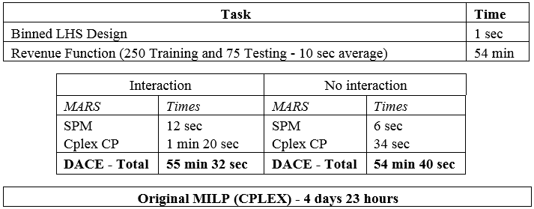
CPU Time Comparisons (MILP vs. DACE MILP)
Findings
The computation time was significantly lower.
The controllability function/revenue function (cost not considered), hence is flexible to handle different cost scenarios.
Ukesh Chawal
79
Notes:
In DACE Generating Binned LHS design, collecting revenue, fitting MARS and optimization step took roughly around 1 hour.
This, in comparison to the original computation time of 5 days in MILP, is the most desirable approach in terms of time saving and resource saving.
Since revenue function is generated hence different cost scenarios can be easily studied.

Slide 80
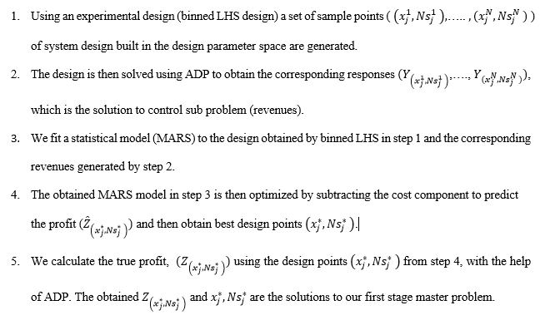
DACE Steps
Ukesh Chawal
80

Slide 81
Literature Review on two-stage or multi-stage
Pilla et al. (2008) utilized two-stage framework to assign crew-compatible aircraft in the first stage, so as to enhance the demand capturing potential of swapping in the second stage.
Pan et al. (2010) developed a two-stage stochastic program to optimally locate the stations (first stage) prior to the realization of battery demands. The second-stage considers the cost of satisfying PHEV demands over a set of scenarios.
Guo et al. (2016) addresses a two-stage framework for the economic operation of EV parking deck (first stage). The second stage introduces a model predictive control-based operation strategy of EV charging dealing with the uncertainty of parking behaviors.
Lulli and Sen (2004) presented a branch-and-price method to solve special structured multi-stage stochastic integer programming batch-sizing problem. They consider a finite-horizon sequential decision process under uncertainty.
Ukesh Chawal
81

